Slide 1
Banqi Game
P2: Domain Model
Team ByteMe
Joshua Henry
Alex Hinterlong
Brian Martin
Stephen Porsche
Evan Salzman

Slide 2
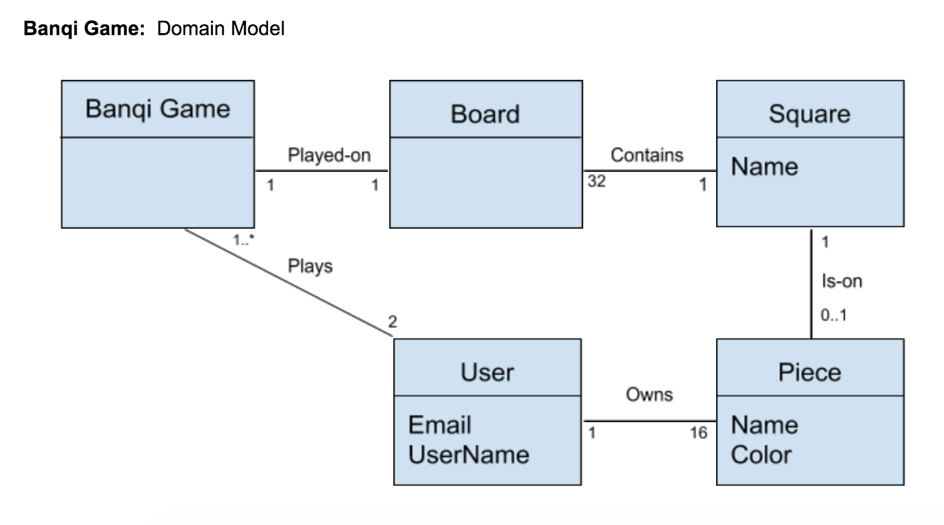
Domain Model

Slide 3
Glossary
Banqi Game: The variation game of chess being played. Instantiates a new board when a user creates a new game
Board: Holds 32 equally-sized squares arranged in a 4 x 8 pattern and all together, create the platform, which permits gameplay
Piece: Has a name and color which defines which piece it is, what the piece can do, and which user owns the piece
Square: Holds 0 or 1 pieces at any given time; may hold the a piece from either user playing the game
User: Plays the Banqi game. Calls the Banqi Game class to set up a new game

Slide 4
Updates to Use Cases
Use case id: | 1
Use case name: | Create User Profile
Overview: | User creates a user profile using an email address, and specifying a nickname to be used during play
Primary Actors: | User
Secondary Actors: | None
Pre-conditions: | User must have a valid email Nickname must be unique User must not already have a User profile
Main flow: | User enters email address to create an account User creates a password User creates a unique Nickname
Post-conditions: | The user now has a User Profile
Alternative flows: | User inputs a non-valid Email - System returns error, asks for valid Email User inputs a Nickname that is already in use - System returns error, asks for unique Nickname
Change: Instead of any random player, we specify an actor as a User
Change: Updated language in Main flow. “User creates a unique Nickname” instead of “Create a Nickname”
Change: Made alternative flows more specific. Now describes when triggered, and what next step is

